Slide 1
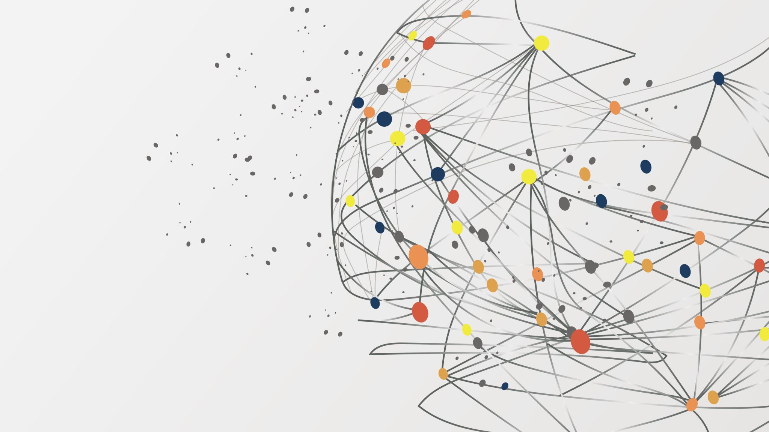
Conditions Assessment and Solution Finding of New Transit Services in the “Bay Town”
CIVENG 259 Public Transportation Systems:
Mihir Thakar
Notes:
Hey guys so this is my project where I did a Conditions Assessment and Solution Finding of New Transit services in the ‘Bay Town’ and ill give you an idea of what that actually is

Slide 2

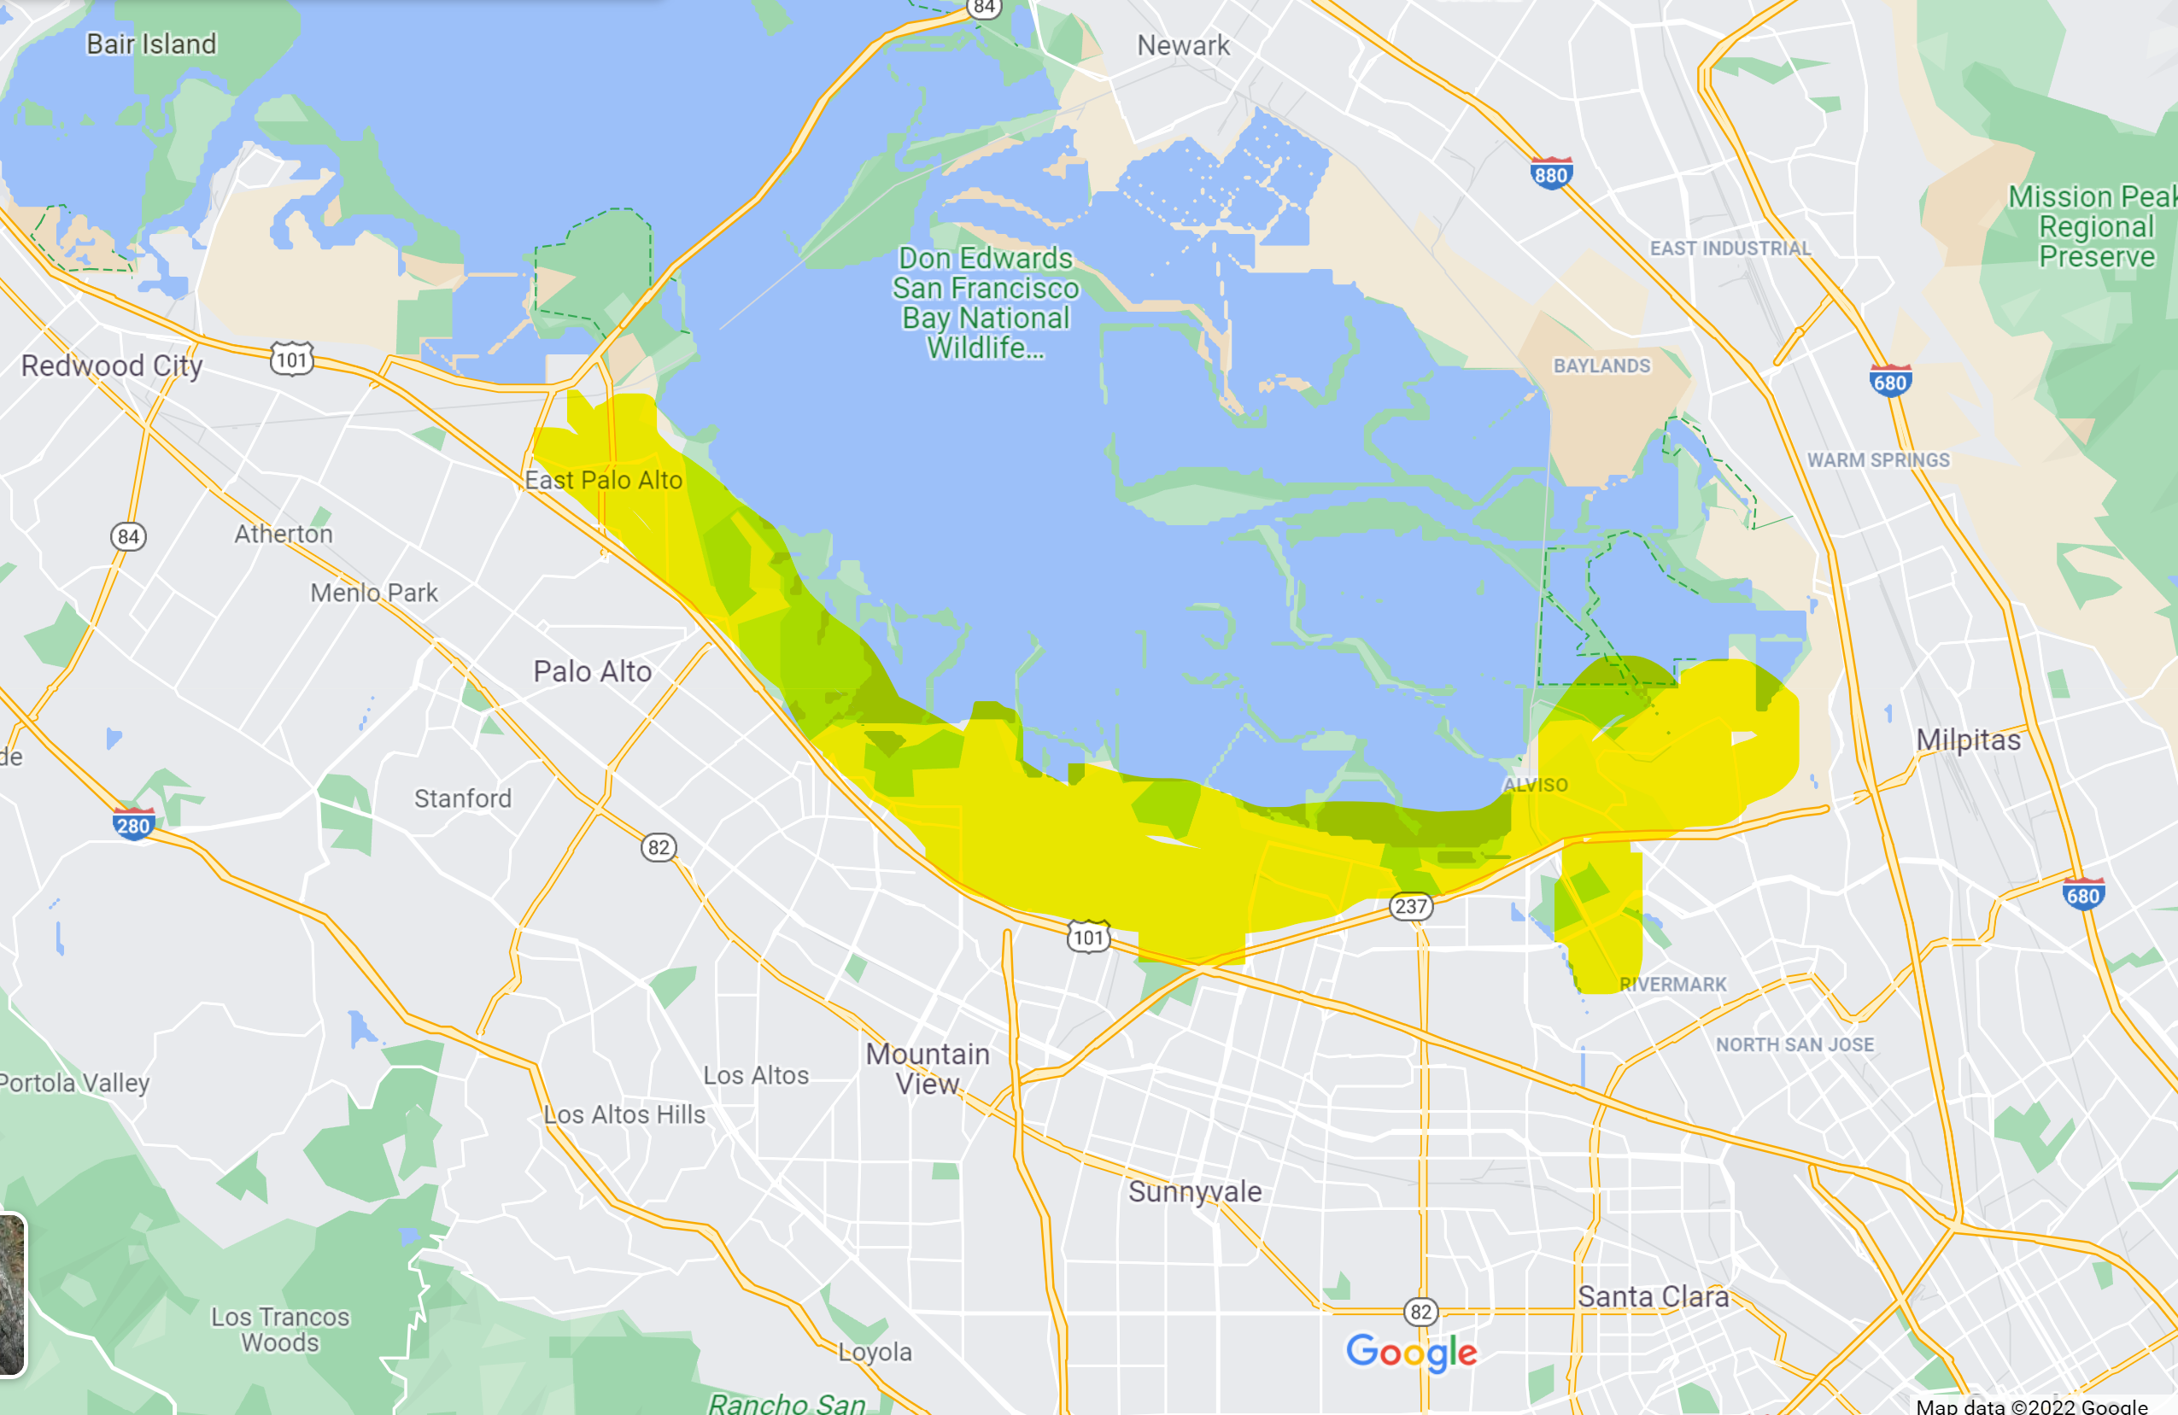
Context
Startup Company: Swyft Cities
Spun out of Google by Former Head of Transportation Planning: Jeral Poskey
Pre-pandemic: Google-Centric transit system
Sustainability and Real Estate initiative
Pandemic scrapped Google Campus only plans
Addressing the “Transit Desert” of the Bay Area (Highlighted area above 101 and surrounded by 85 and 880 on the right)
This Photo by Unknown Author is licensed under CC BY-SA
Notes:
I think I need to give some context about the project itself
I was just scrolling linkedin one day and saw this post about this new start up company called swyft cities and how its promising to revolutionize transportation solutions specific to the bay area, which is relevant to me given I was born and raised there, and I saw it was posted by Jeral poskey who after a little bit of linkedin stalking I found out was the placcomplished ex head of transportation planning there at google
I managed to pester him a bit with a couple of emails and was able to set up a call and a couple meetings
He told me his mission to provide a new modality was actually a project spearheaded at google before the pandemic to install a cable car system for the new google campus for their employees to avoid the rush hours often found in this transit desert highlighted there
Ultimtaely the pandemic scrapped these plans and mutually agreed to actually make this a regular transit service as a solution to the entire transit desert area that is highlighted here
And so you’ve been hearing me refer to this area as a transit desert repeatedly and ill give you an explanation of why
This is a primary location of many tech campuses in the silicon valley but there is little to no ridership of public transit to get to these offices
It is just a part of the daily lifestyle at least prior to the pandemic to deal with congetsted roads on your way to work whilst living in the surrounding area

Slide 3
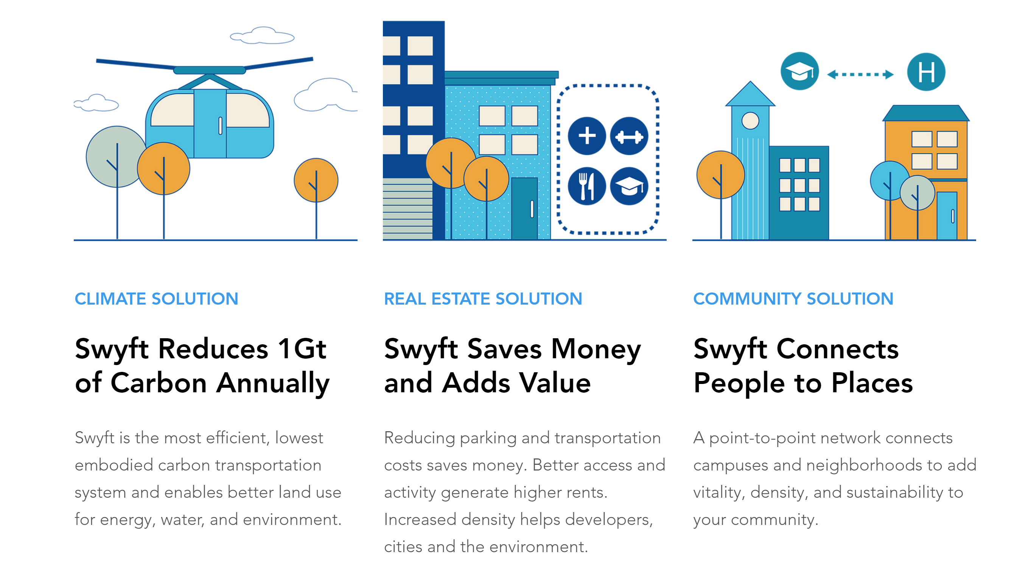
Swyft Cities Idea
How?
Cable Car System
Sustainable
Last/First Mile connector
Uncongested Mobility
Uncongested Mobility
Reduce costs, and increase revenue for
Real Estate Developments
Airports
Universities
Tourism Destinations
Reduce Parking
Avoid Roadway congestion
Connect residential housing developments and CBD’s
https://www.swyftcities.com
Notes:
So looking at the issues before the proposed solution that actually needed to be solved is theres rapid real estate development of high density buildings in and around the south bay area that are both of with tech campuses and residential buildings that make up the flocks of people who work there.
In order to reduce costs, increase revenue reduce parking and avoid roadway congestion with a network in a sustainable fashion it became abundantly clear that the only way this could be done is using a cable car gondola system
How to accomplish the left ideas go for a cable car system
Autonomous Cabin + Cable System

Slide 4
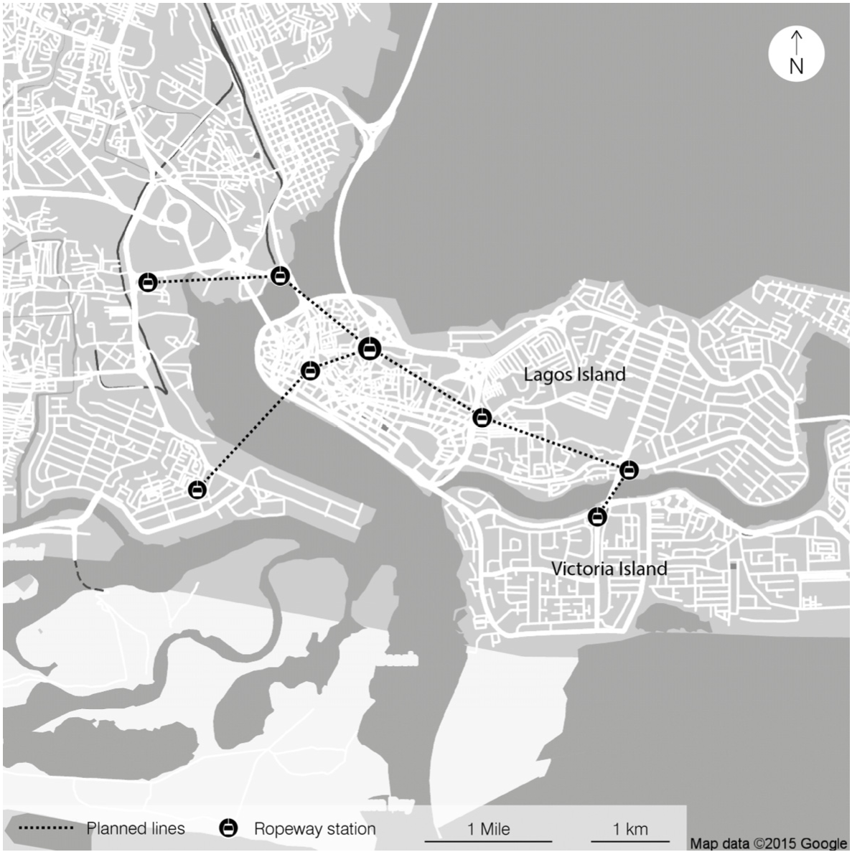
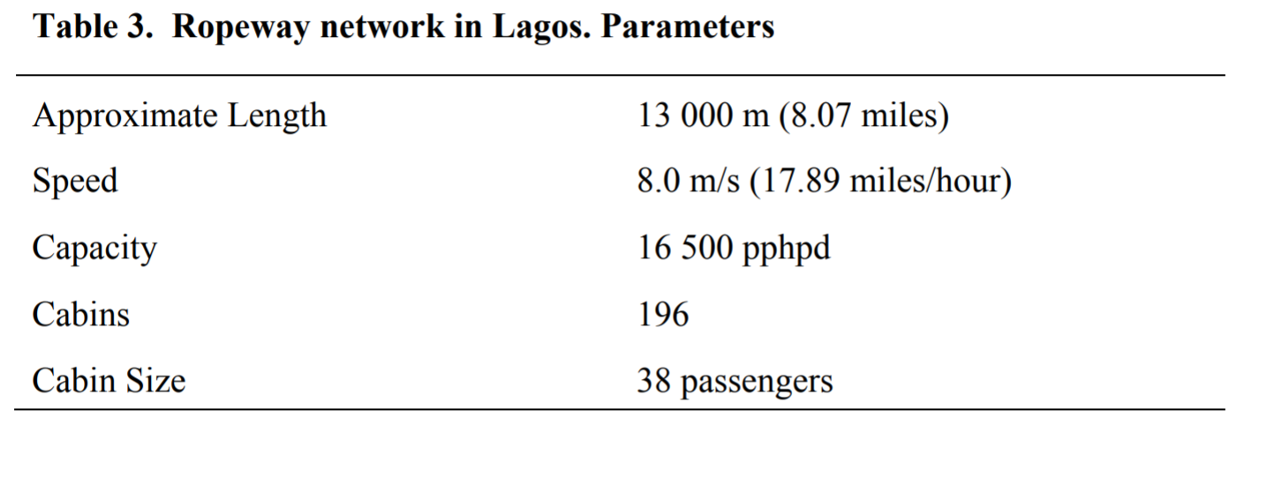
Cable Car Concept
Ropeways feed networks with challenging topography
Minimal Land Use
100% Electrically driven
Lagos Nigeria Case Study
Government Buildings
Places of Worship
Offices
Retail
Notes:
Here is an idea of what is usually considered when installing this transportation modality based on a case study in Nigeria
So for context Victoria Island is the center for banking and the financial district of Lagos but there is insane congestion between all the islands and they have a BRT system but really isn’t used all that much
So a cable car system would avoid the congestion of the 3 bridges and provide a modality with parameters as seen in Table 3.
Theres already a lack of transport infrastructure so it would be economical to invest in a sustainable alternative to reduce car driven transit

Slide 5
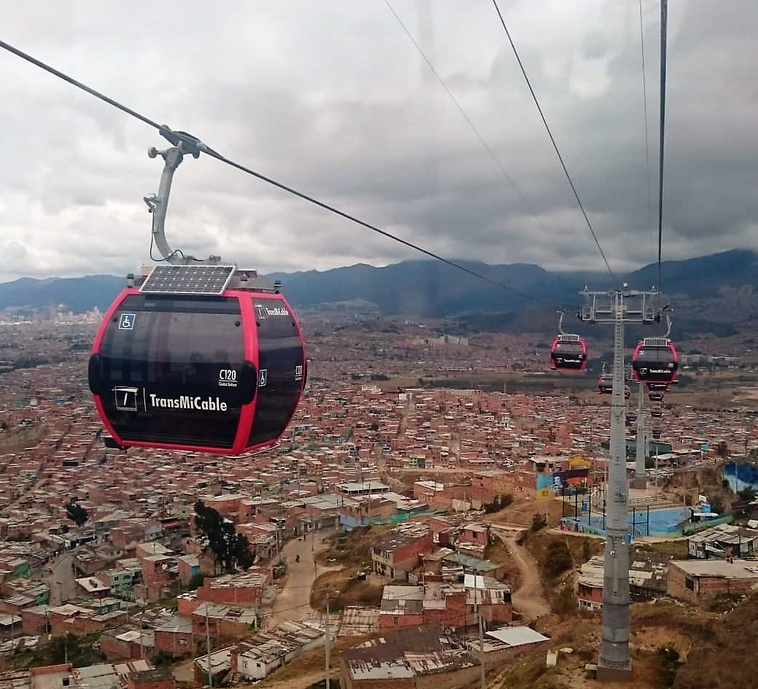
Cable Car Applications
TransMiCable in Bogota, Colombia:
Publicly Funded
Subsidiary of TransMilenio BRT System
Portland Aerial Tram (OHSU Tram)
Jointly Funded by City of Portland and OHSU
Connects Waterfront district and campus Health Center
LA Aerial Rapid Transit Proposal:
Privately Funded
Between Union Station and Dodgers stadium
Notes:
If it weren’t already clear gondolas are great for areas with varying geographical properties Hence they are often used at ski resorts
Here are some of the applications of actual cable car systems:
This is the TransMiCable in Bogota Colombia
Juliana Lucia if I said anything incorrect feel free to call me out the floor is yours haha
In terms of the US
Oegon Health and Science University waterfront district and health center
The most controversial one is for my LA boys here which is funded by former dodgers owner Frank Mccourt
This is going through the ringer with public outcries over it’s spark of gentrification
Proposed 7 minute trip from union station to dodgers stadium
Outcry because at its lowest it is nearly 40 feet above some homeowners and every 30 seconds on game days with 40 people packed in a tram could be looked at as an annoyance
Most of the issues with the project stem from some say there are no discernable benefits to LA metro and taxpayers and that it is more of a private tourist attraction which I fundamentally disagree with given baseballs popularity especially the dodgers

Slide 6
First steps
Data Collection
Transitland GTFS API
VTA: Valley Transit Authority
Primary Transit Agency that covers the Silicon Valley: Santa Clara, Sunnyvale, Cupertino, Mountain View, and San Jose
Most recent update on 3/8/2022
Notes:
After conducting some literature review and understanding current cable car systems I wanted to know about the use case in the area previously described as the transit desert which I highlighted
So im also taking 255 Urban Informatics where our professor Ma told me about Transitland which has updated GTFS feeds for pretty much all transit agencies so I was able to access the API and get the GTFS data and I used that in conjunction with ridership data from the VTA and I can give you an example of what I worked with visually in the next slide

Slide 7
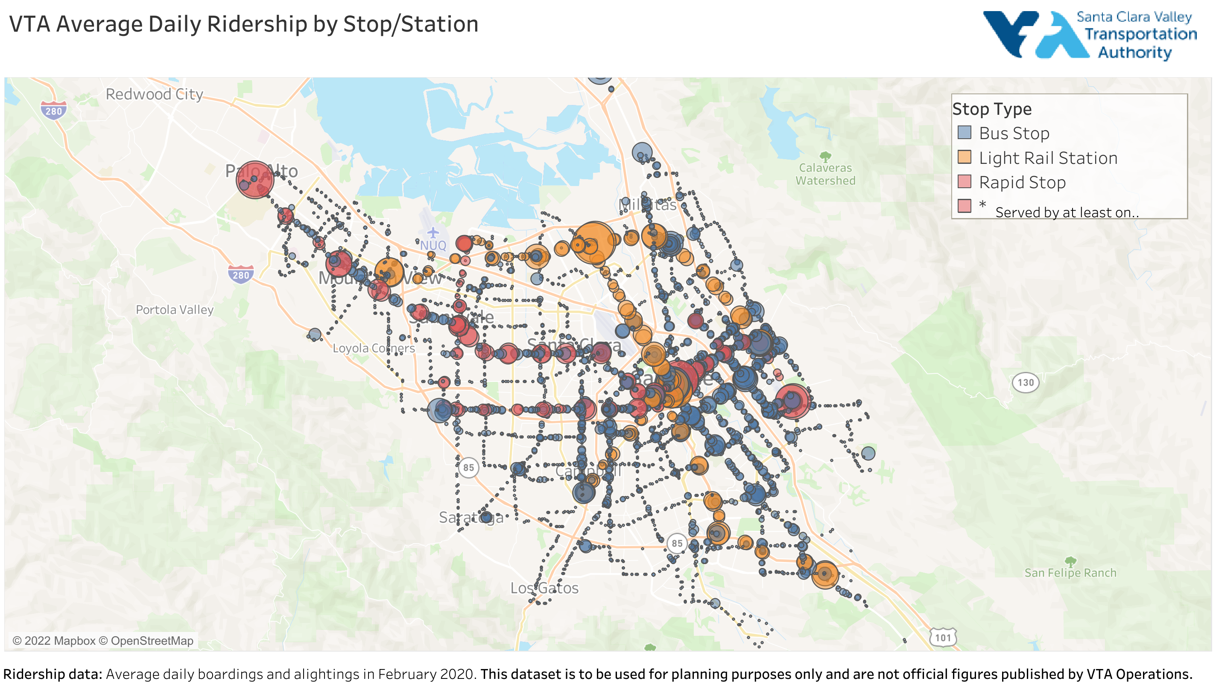
Notes:
So here is a robust datamap that showed ridership by stop and station and when you go over the bubble it would give you 2 options to look at weekly or weekend ridership data

Slide 8
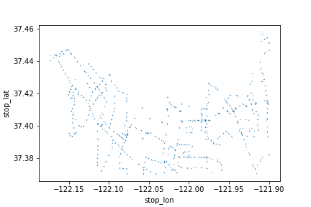
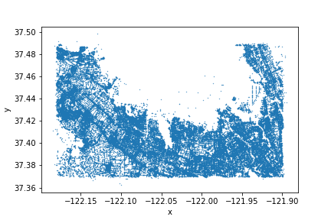
Urban Access
Initial Parameters
Bounding Box for Transit Desert (Northern parts of Palo Alto, Mountain View, Sunnyvale, Santa Clara, San Jose, and Milpitas) surrounded by Highway 101, 85, and 880.
Tech Campuses range from Facebook in top left down to LinkedIn to Cisco in the right
Bus Stop Network
Pedestrian Network
Notes:
Now here is the fun part so I was able to really hone in on my geopandas skills from my 255 class and used this package called Urban Access which was spearheaded by former professor Paul Wadell a couple of years ago
So I first established the bounding box manually according to some lat lon values
And the top is the bus stop network and bottom is ped network
I know they aren’t super detailed right now but it actually took a lot of time for this code to run and I swear it will be worth it in the end result
What this package provided was an avenue for me to use my gtfs data combined with census block data of jobs and come up with metrics for job accessibility by transit
So let me give you a run through of what that pipeline looked like.

Slide 9
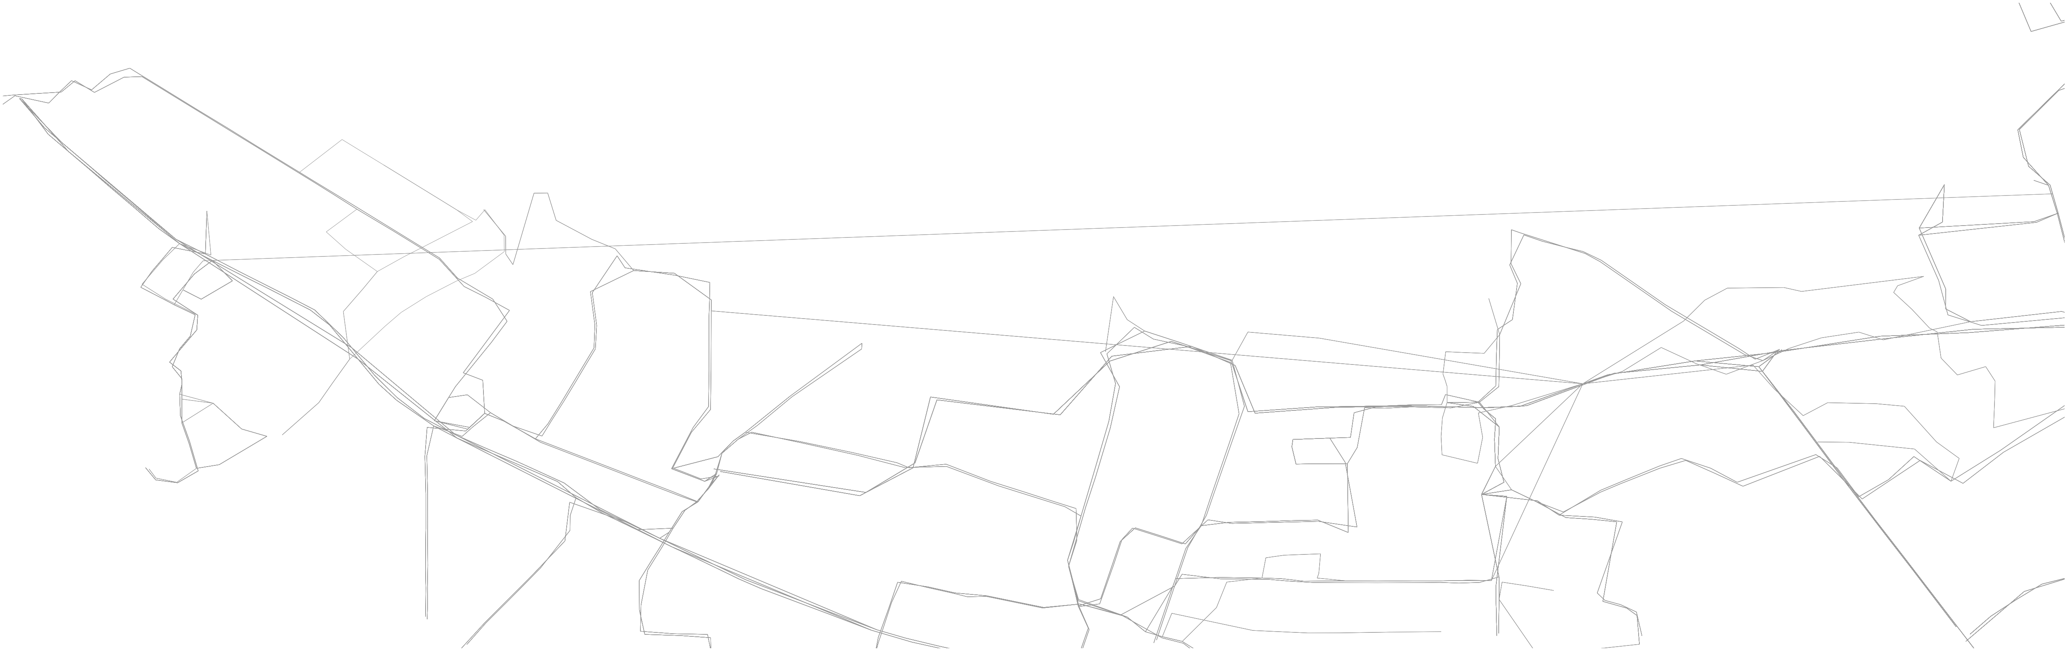
Transit Network in Bounding Box
Notes:
If you guys are familiar with openstreetmap that is whats going on in the background as that’s what a lot of this package is built off of
So the first image is the sparse transit network not a very attractive picture at all and that’s not the code that’s realy just because of the subpar system

Slide 10
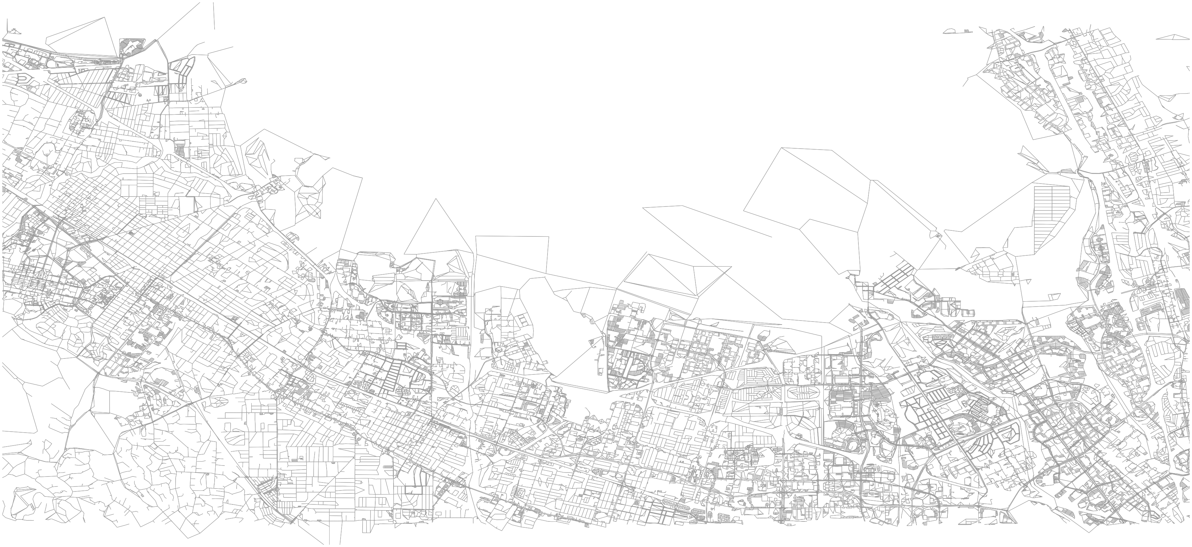
Pedestrian Network in Bounding Box
Notes:
Moving on we have this PedNet it seems very robust and walkable but that’s just cause theres el camino real which is just an extensive street of retail and office

Slide 11
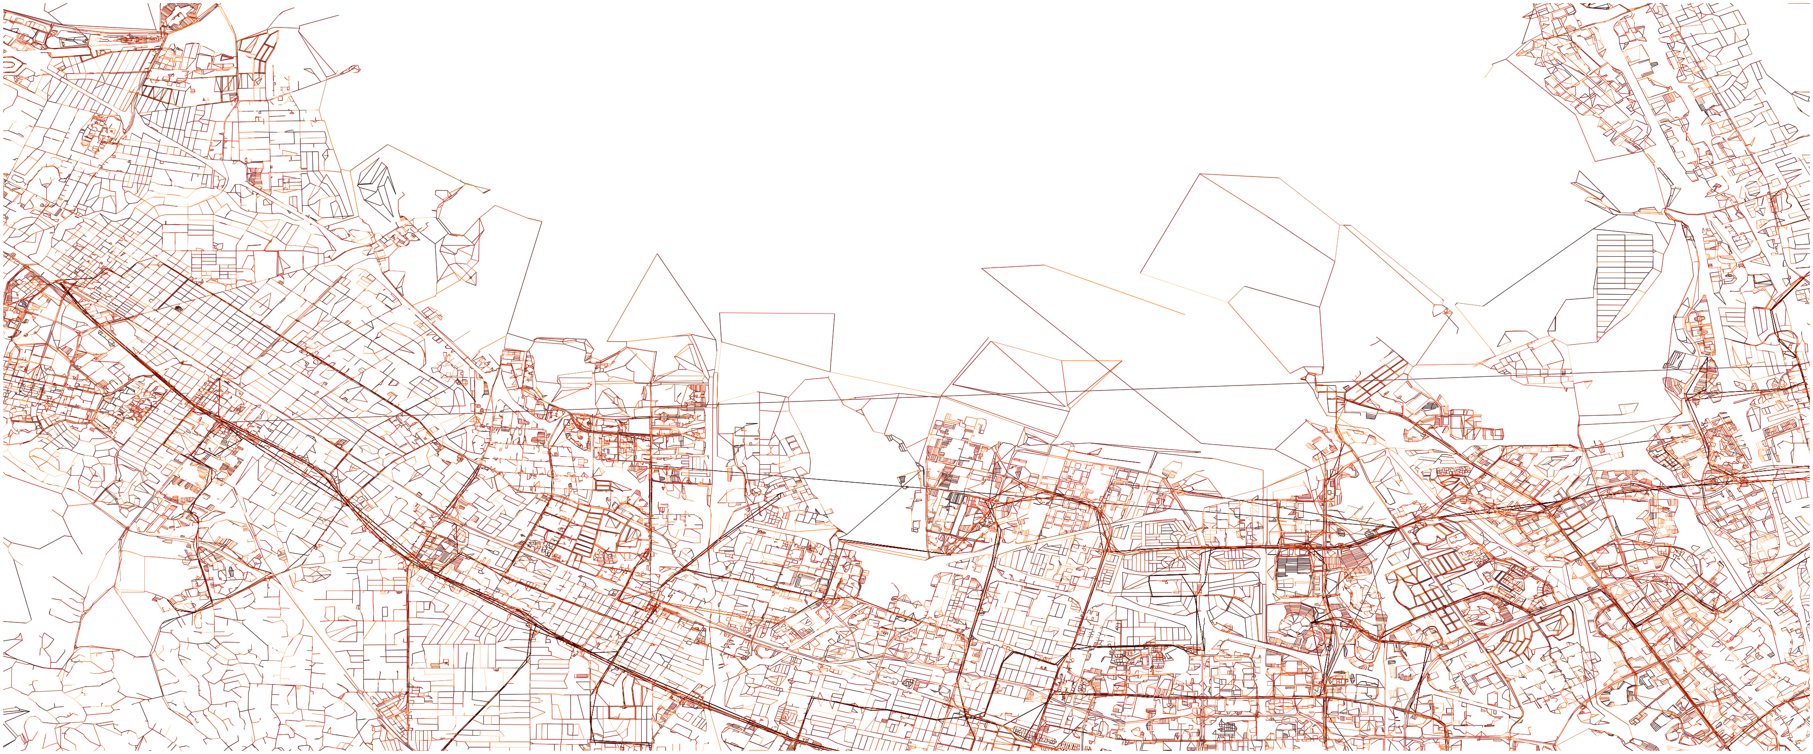
Transit-Pedestrian Network in Bounding Box
Note*
VTA's major bus arterial routes (in darker red) and transfer locations with the underlying pedestrian network.

Slide 12
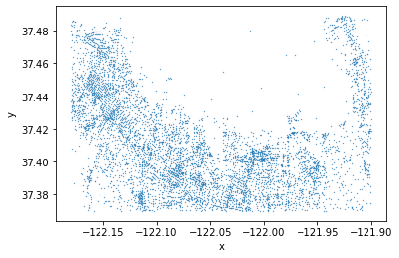
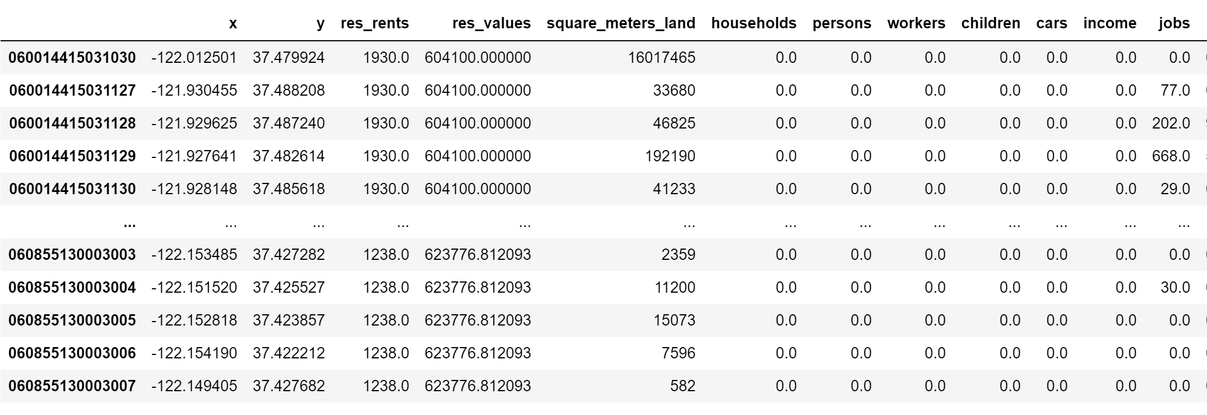
Census Block Groups Visualized
Notes:
Well whats the purpose of all that? I am doing a conditions assessment and so I was able to get census data for the jobs in the block groups of this surrounding area using the same lat lon bounding box I have been using this entire time

Slide 13
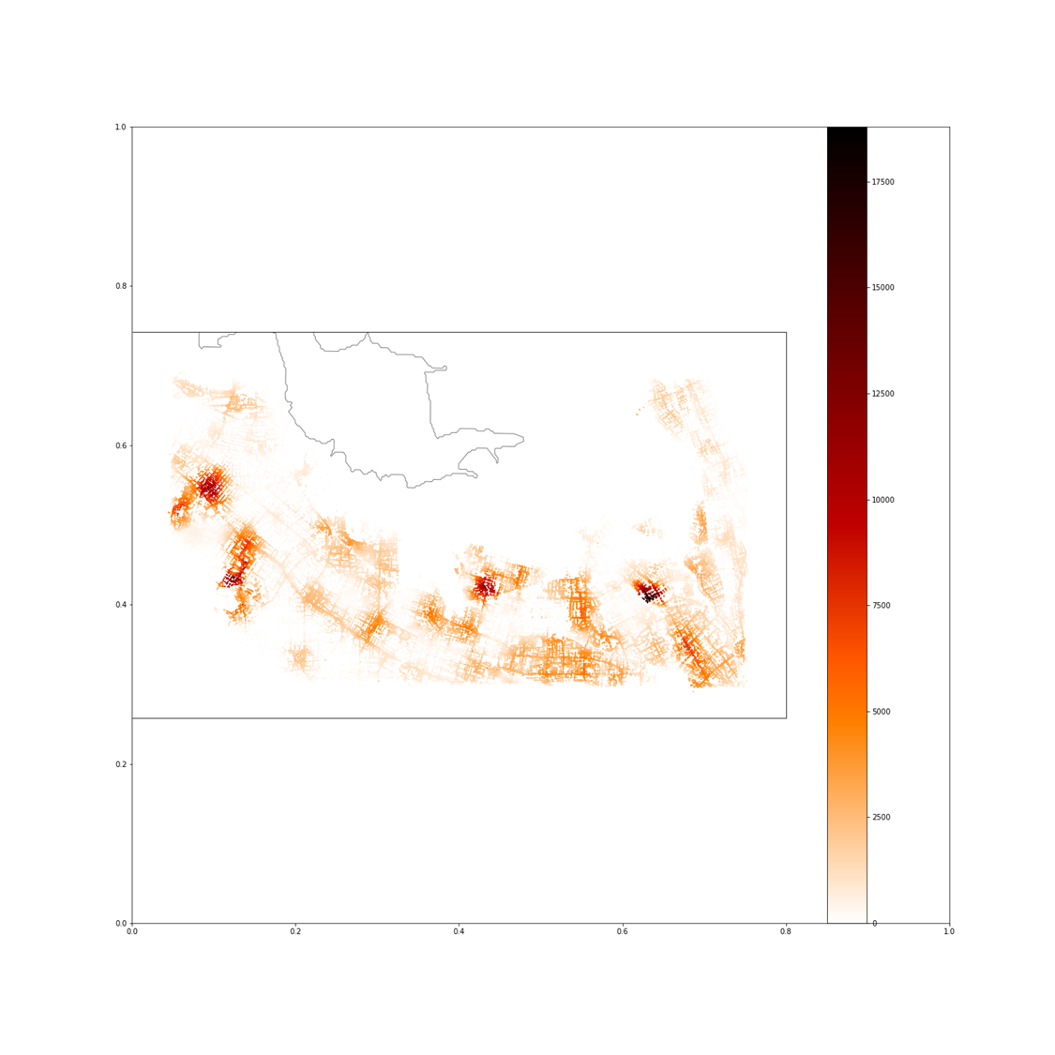
Job Accessibility by Transit-Pedestrian Network: 15 minutes
Notes:
And Boom
This was my final product keep your eye on the y axis of jobs as best as you can

Slide 14
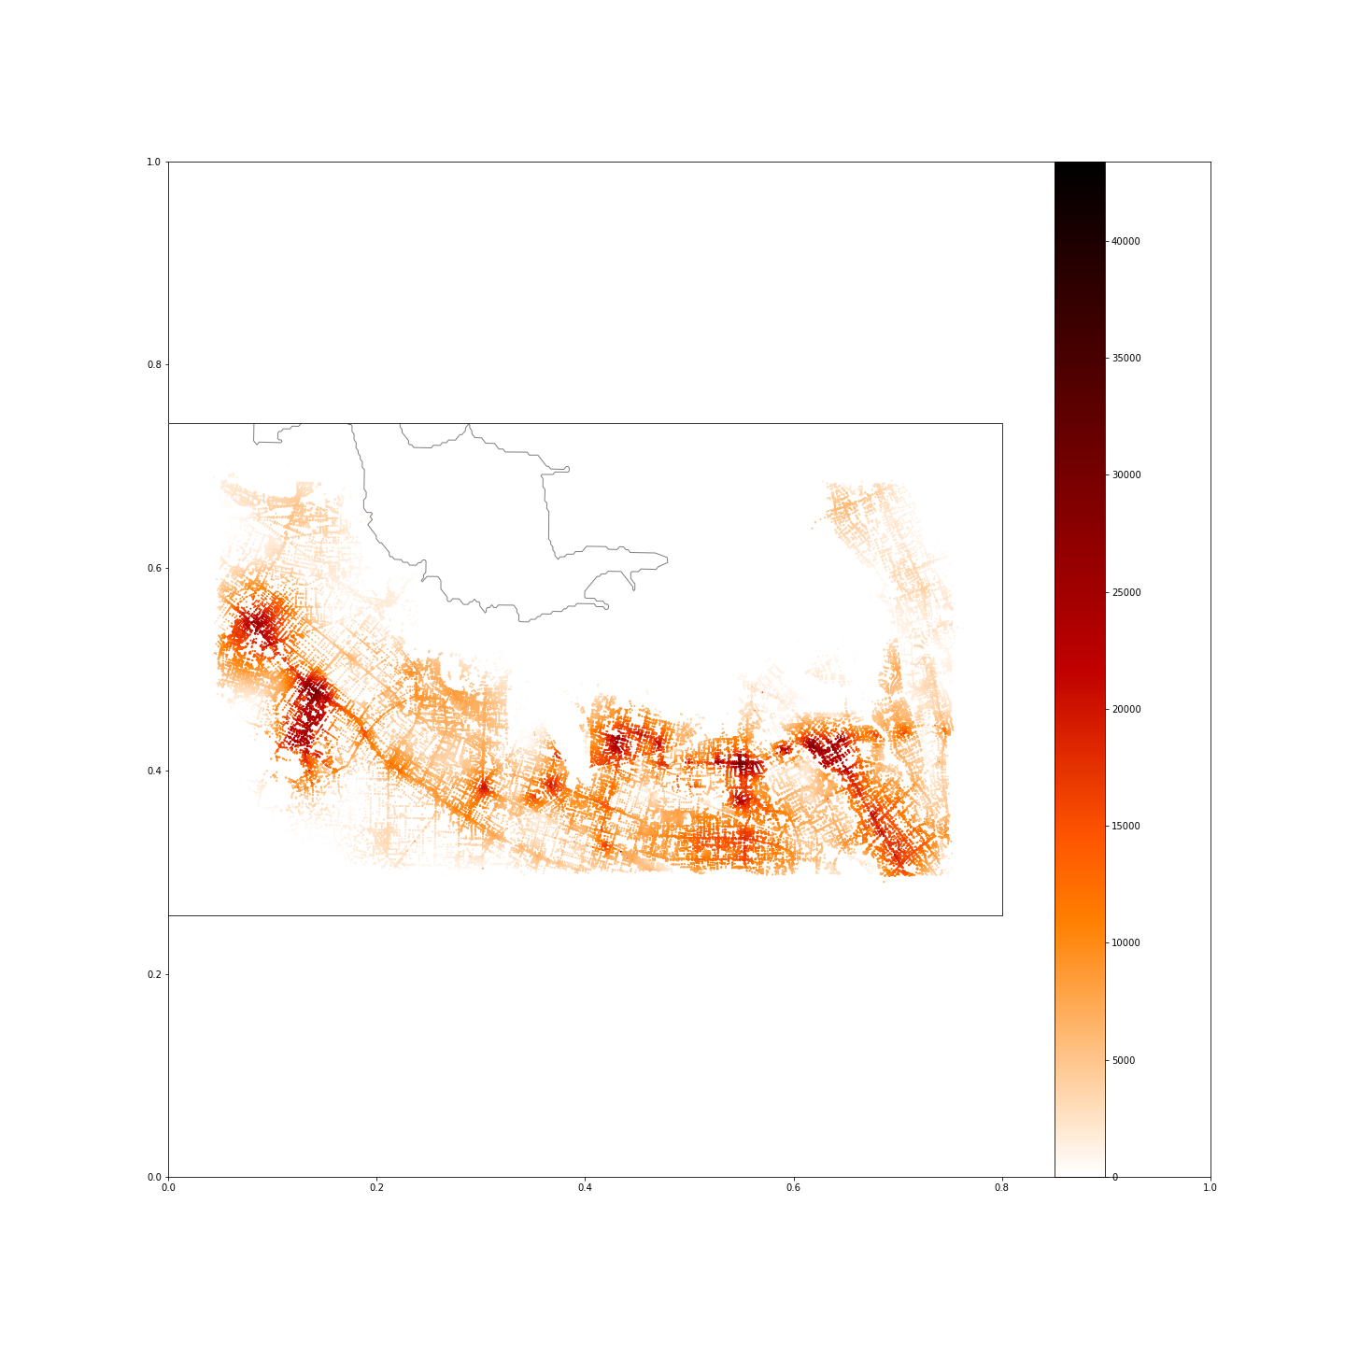
Job Accessibility by Transit-Pedestrian Network: 30 minutes

Slide 15
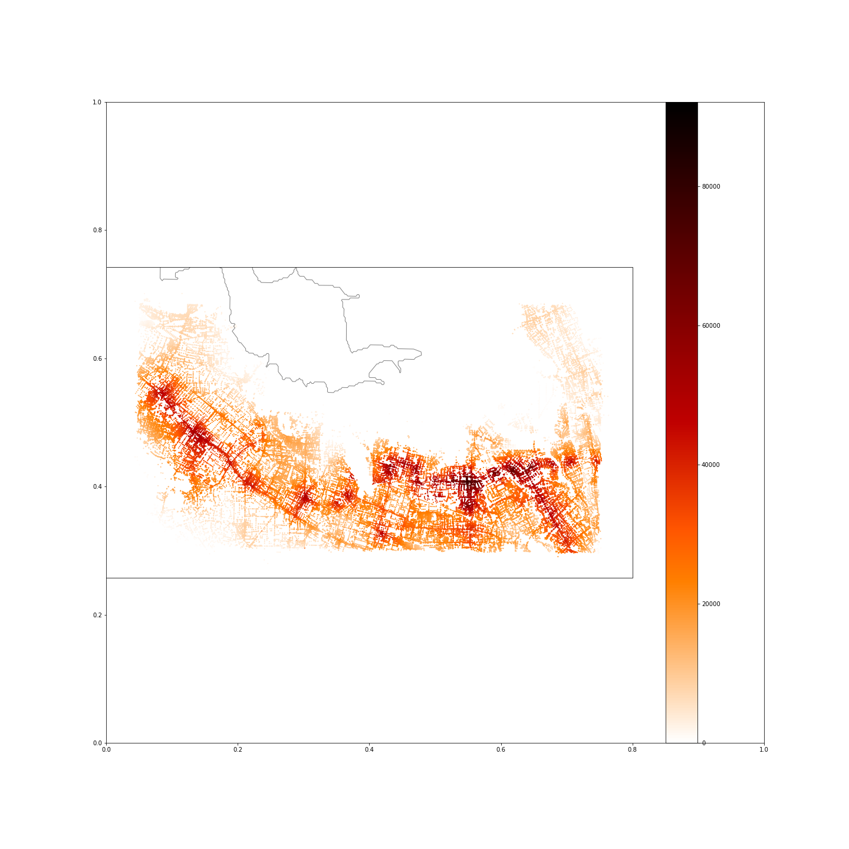
Job Accessibility by Transit-Pedestrian Network: 45 minutes
Notes:
So obviously there is a huge degree of difference for using transit and job accessibility, 15 minutes itself is a stretch to get to your workplace using transit. Therefore its obvious why a majority of this tech area is congested on their roadways because it makes no sense to use transit to get to work. But If there were other modalities, it would reduce congestion and maybe allow for less congested roads. Obvously a cable car system would be catered to higher income demographics at first but if anything, it technically could cut a lot of the congestion in roadways themselves

Slide 16
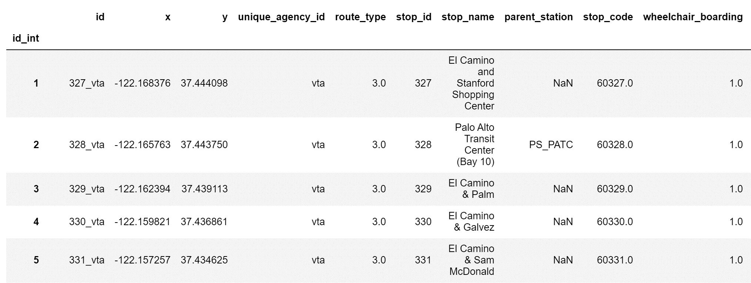
Model Development
Notes:
So in terms of some model development the urban access package provides a clean dataset of the nodes of each of the stops and their correposnding attribtutes and I merged that with my previous jobs dataframe of ridership

Slide 17
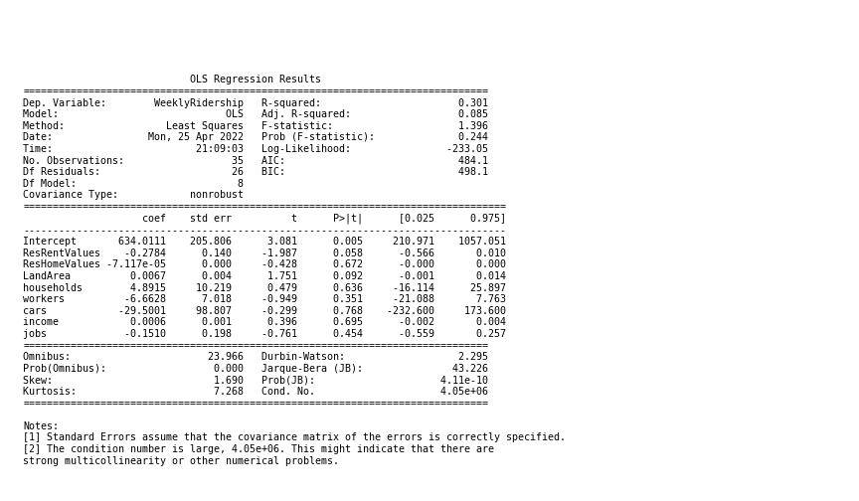
Weekly Ridership Models
Least Squares Model
Notes:
This is where I struggled the most, I had to hardcode some ridership data, just needed more time to properly connected jobs dataframe and census data with the ridership data to link them together, I did it unique agency ID and a node id but there wasn’t the greatest match
As you can see most of it makes sense cars coefficient is quite large depicting how as number of cars increases weekly ridership will decrease
Issue with jobs if that increases weekly ridership decreases as well so that is counterintuitive

Slide 18
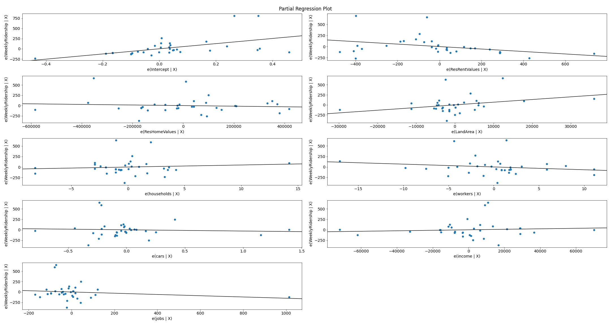
Notes:
Heres some of the partial regression plots

Slide 19
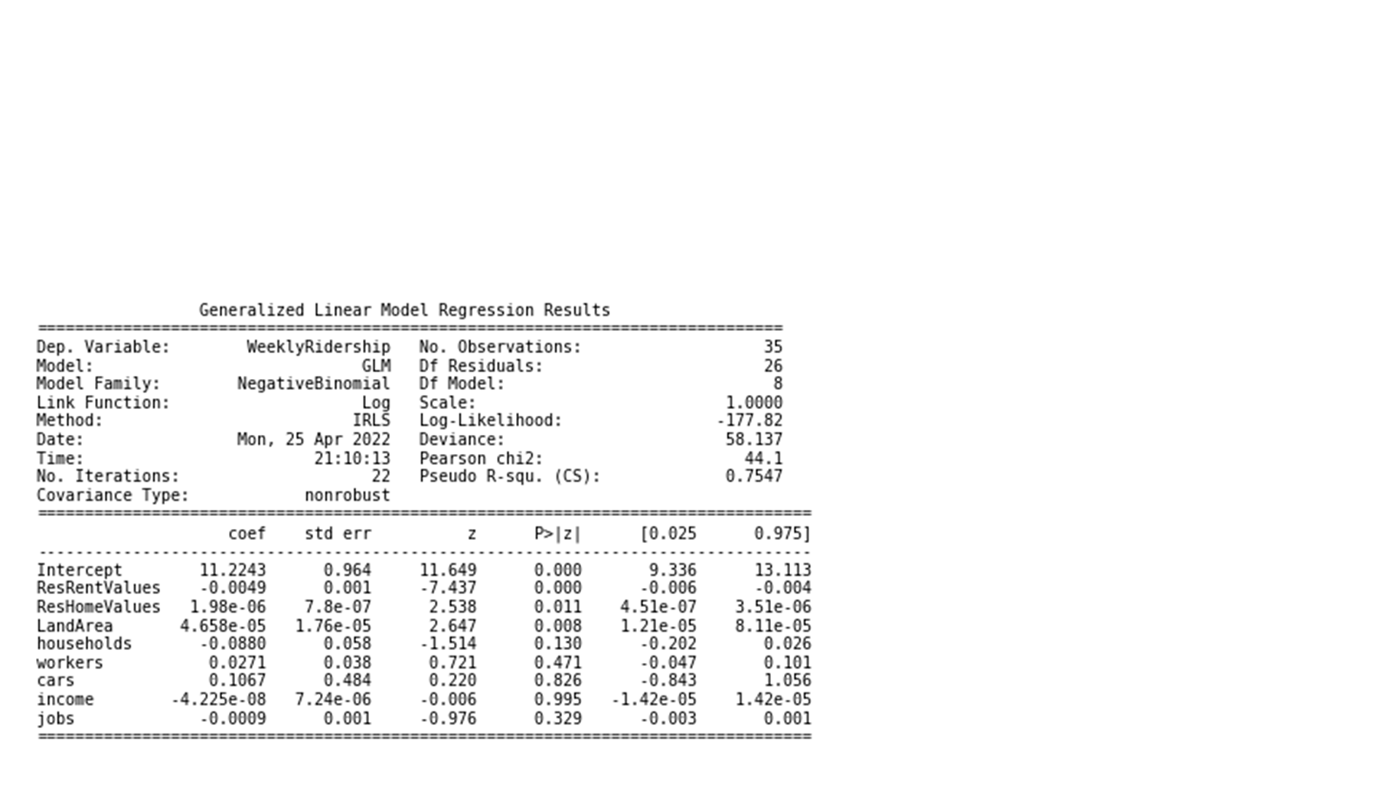
Weekly Ridership Models
Negative Binomial Model
Notes:
Here the cars did not make sense as a positive coefficient
Jobs has the same issue

Slide 20
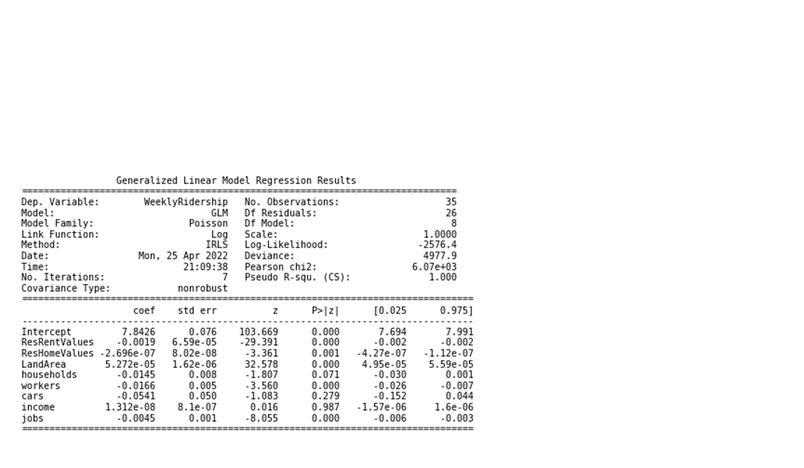
Weekly Ridership Models
Poisson Model
Notes:
And a poisson model

Slide 21
Next Steps & Recommendations
Obtain Swyft Cities parameters for their own Cable Propelled Transport:
Cabin Size
Speed
Link Length
Primary Sources of Funding
Hybrid Work Model:
Recent Phenomenon that tech workers actually living further away, and more willing to drive longer distances 2-3 days/week
Future Work (past Job Accesibility):
Office
Retail
Industrial
Housing
Largest Employer Data
Notes:
Get the parameters for swyfts own system and its implementation create a network
Tech workers are actually living further away, and are more willing to drive further distances knowing they only have to come into work 2-3 days a week
Later on recommendations future work. I only did job accessibility more of the project will deal with future growth so understanding where new developments are being made such as office, industrial, retail, and most importantly housing. Bc the idea is to connect CBD’s with their immediate locales and housing to avoid roadway congestion of all kinds.
I was also able to find a resource that had information about the 50 biggest employers in the silicon valley (not just tech campuses either) with information about their employee headcount and office addresses but unfortunately it was hidden behind a paywall past the 5 biggest ones like facebook apple and google but that would be a great start to begin a network analysis with weighted populations

Slide 22

Thank you for listening!

